Slide 1
Lego Robotics Orientation Day

Slide 2
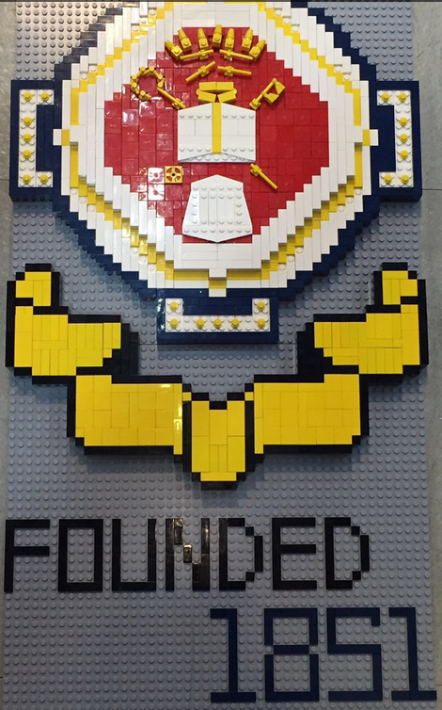
Welcome to all students interested in joining our Team.
Team members last year:
President: Bernard Lo (4F)
Vice president: Anson Law (4B)
Committee members: Thomas Lai (4A)
Colin Chow (4B)
Linus Lo (4F)
Ryan Kwok (4F)

Slide 3
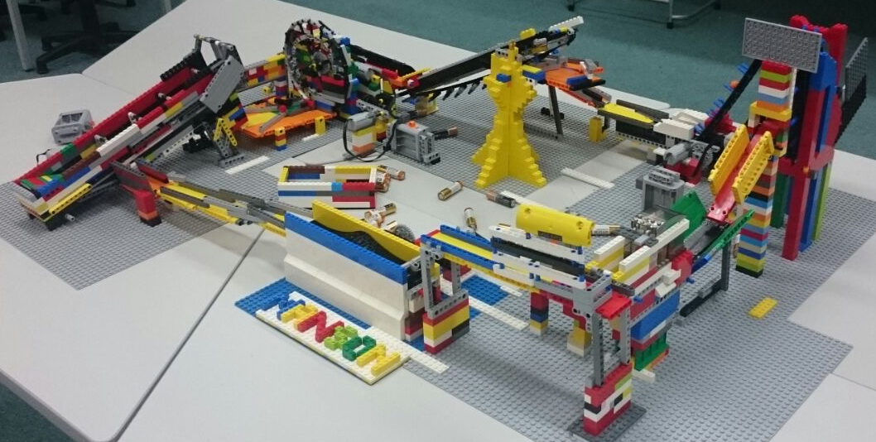
What do we do?
We participate in competitions and inter-school exhibitions. Also, we build large scale lego projects like the Great Ball Contraption.
List of competitions we participate in the last year:
World Robot Olympiad
FIRST LEGO League
RIDIY

Slide 4
Still want to know more?
We play Lego only for fun. However, we still hope to win competitions and attend exhibitions. We learnt programming and hardware building in the process. This is a valuable skill in this computer-oriented generation which is becoming increasingly more important. Through joining our team, you can learn these skills in a stress-free environment.

Slide 5
This is a video about our team’s activities
Sit back and enjoy!
https://youtu.be/_C4RkIlPWrQ

Slide 6
Any questions?
You are most welcome to ask us.

Slide 7
Thank you

